Slide 1
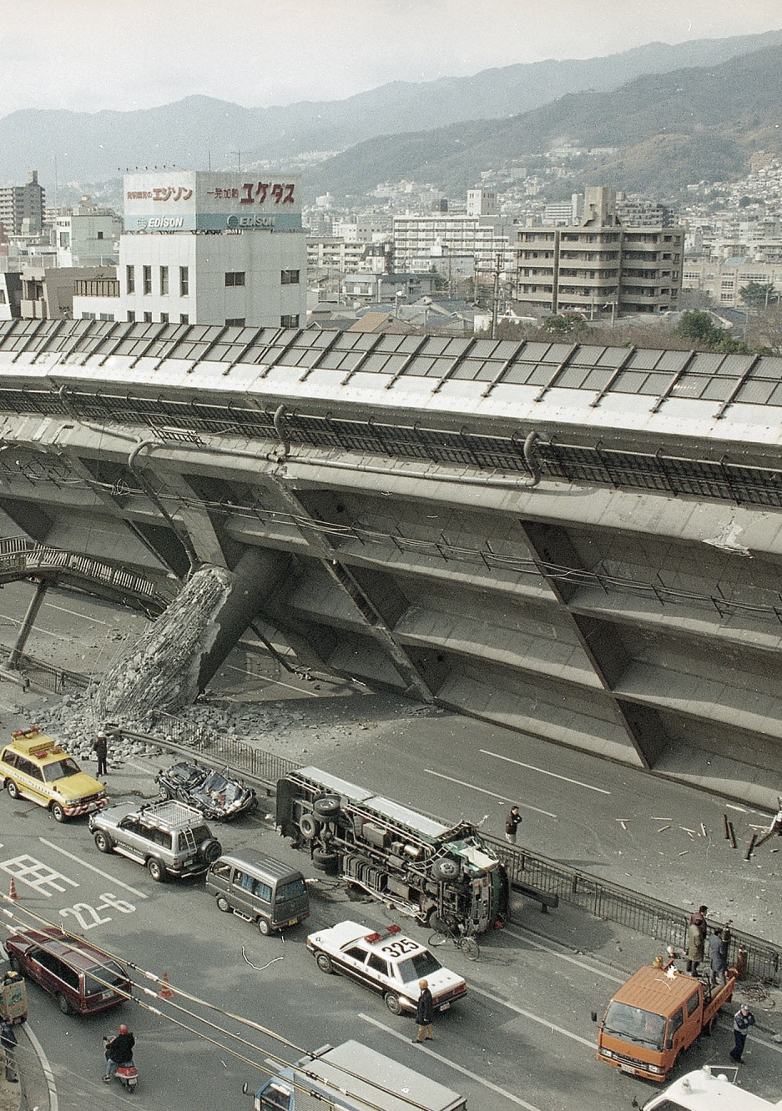

Black-box Model for Seismic Activity Kobe Earthquake, 1995
Federico Cantarelli
Project Work Data Driven Modelling of Dynamical System and Optimal Control
A.Y. 2022/2023

Slide 2
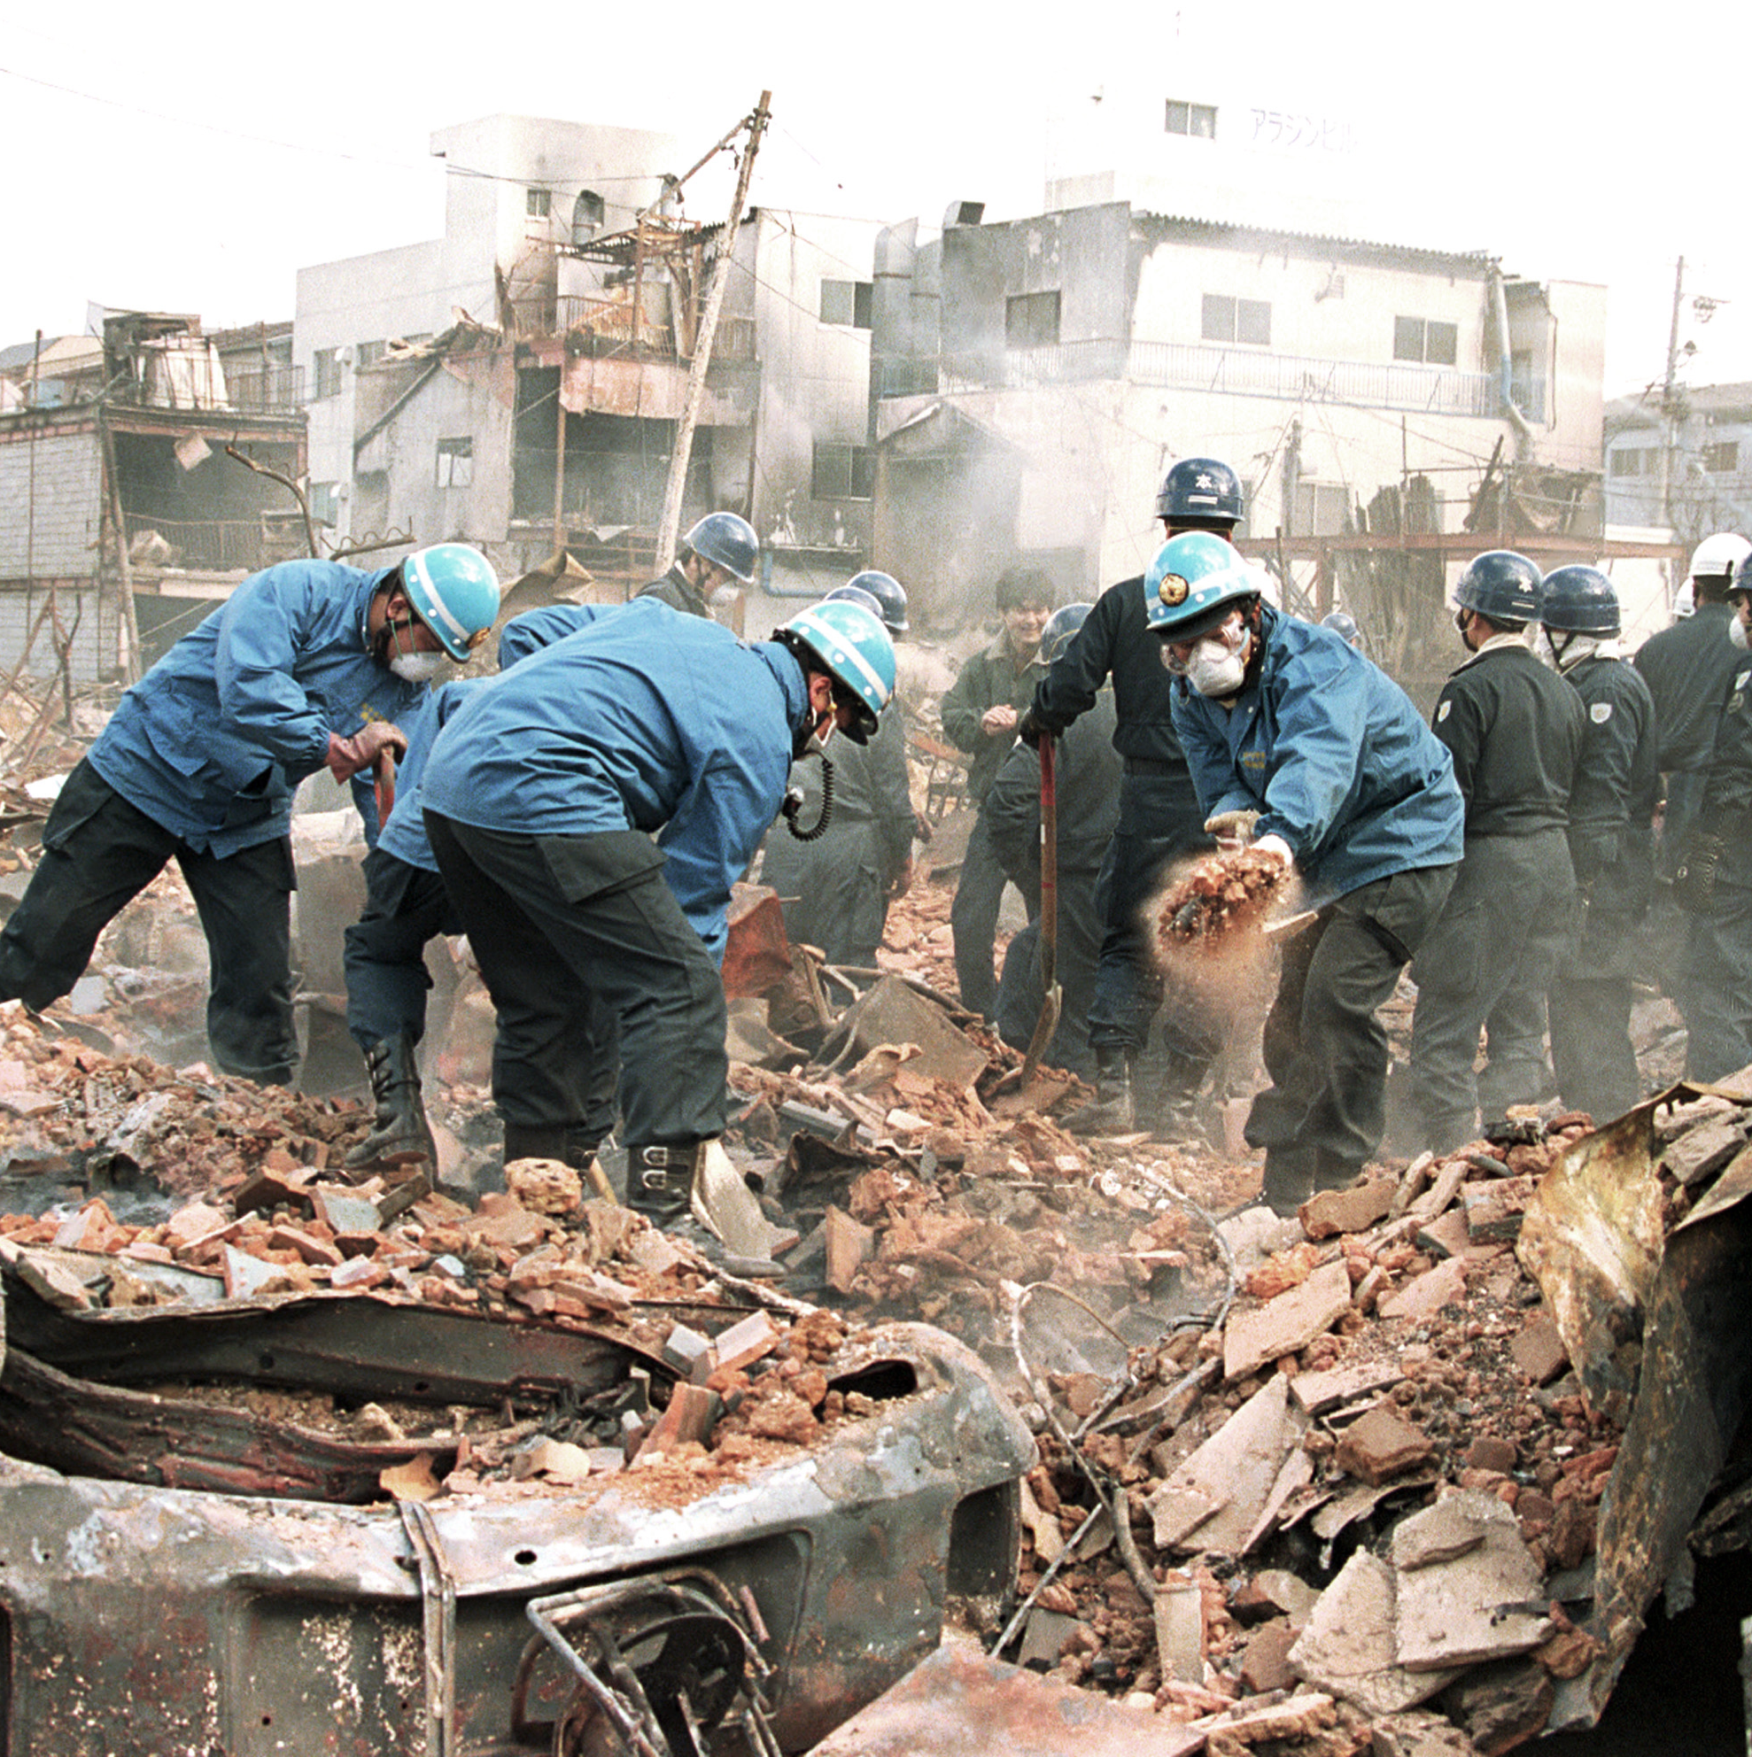
Context
The dataset contains seismic activity from Kobe earthquake happened on 17th January 1995. It had a magnitude of 7.3 MW (USGS) and tremors lasted for about 20 seconds. There are 3048 total samples taken at discrete time periods.
The goal of the project is to investigate whether it is possible, from the model built on normal activity data, to predict the earthquake measurements.

Slide 3
01 – Preliminary analysis
Different activities
Summary statistics
Covariance plot and spectrum
ACF and PACF
Model Structure

Slide 4
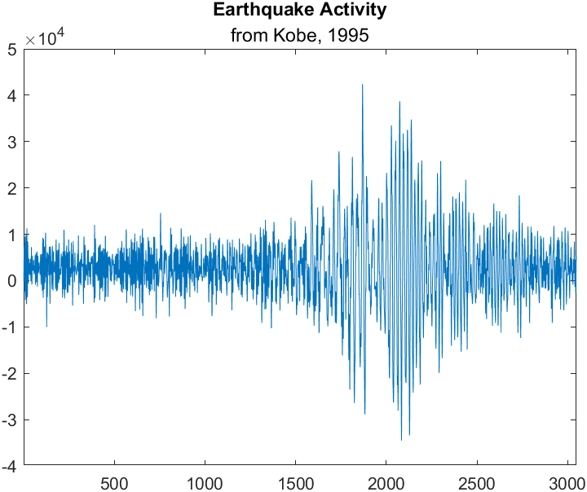
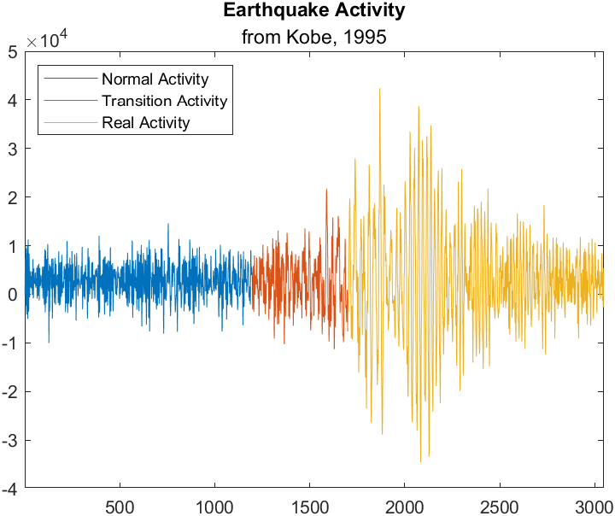
01 – Preliminary analysis

Slide 5
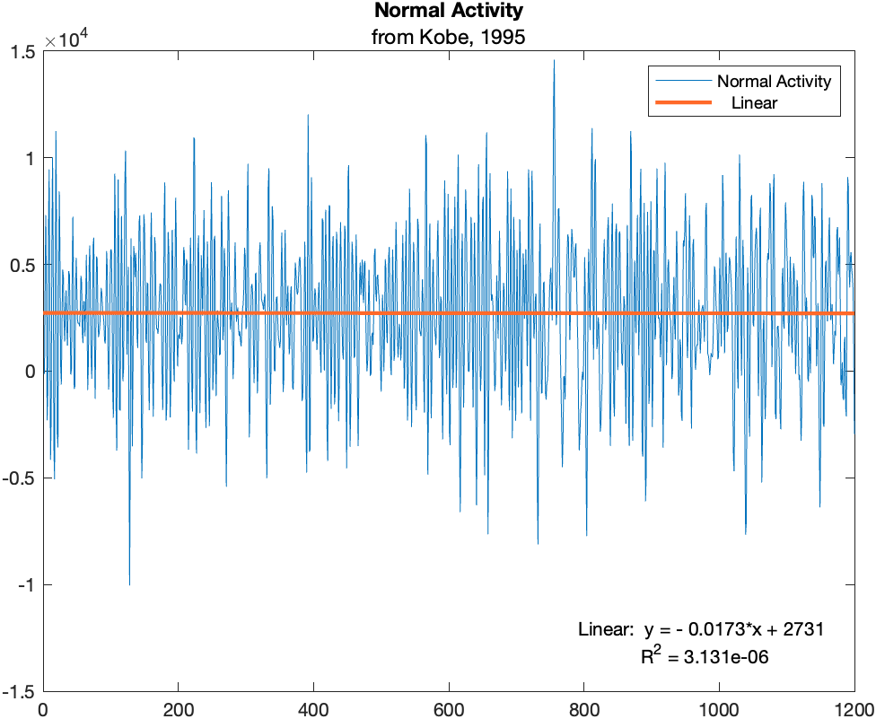
01 – Trend analysis
Time series doesn’t exhibit any trend, it’s biased though. Indeed, the mean of the normal activity data is about 2,700.

Slide 6
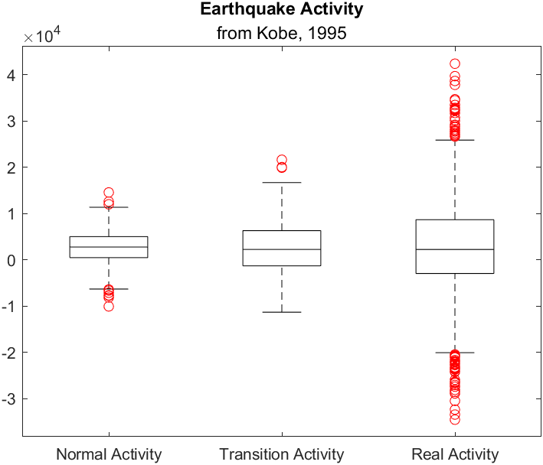
01 – Summary statistics
Activity | Mean | StDev | Range | Min | Median | Max
Normal | 2,720.3 | 3,389.1 | 24,642 | -10,045 | 27,890 | 14,597
Transition | 2,503.9 | 5,488.6 | 32,955 | -11,289 | 22,770 | 21,666
Real | 2,631.6 | 10,613.58 | 76,950 | -34,522 | 22,665 | 42,428

Slide 7
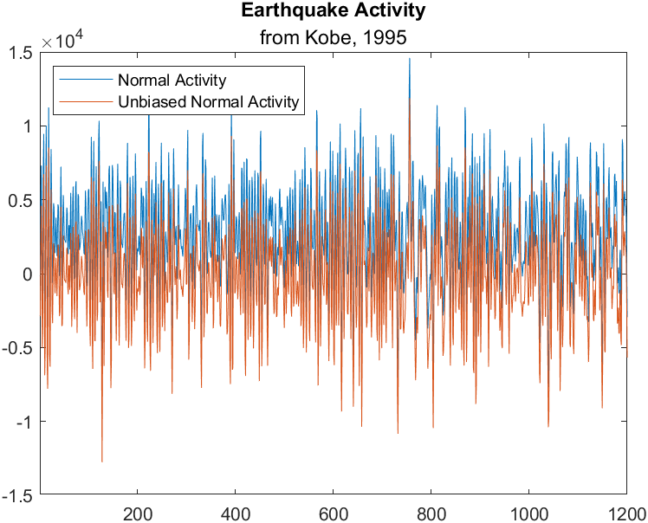
01 – Unbiased signal
As seen in the previous slides, normal activity is not zero-centred. So we can compute un unbiased version of the signal by removing the constant bias of the original signal.

Slide 8
01 – Preliminary analysis
Let’s search for a statistical evidence that variance is different among different phases of the earthquake.

Slide 9
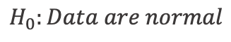
01 – Anderson-Darling test
$$H_{0}:Data are normal$$
Activity | P-value | AD statistics | Result
Normal | 0.3204 | 0.4243 | Fail to reject H0
Transition | 0.6615 | 0.2808 | Fail to reject H0
Real | 0.0005 | 6.5065 | Reject H0
Since real activity observations are not from a normal distribution, we can use Levene’s test, which is less sensible to the normality assumption of Bartlett’s test, to asses if the variance is the same for all the different phases of the earthquake.

Slide 10
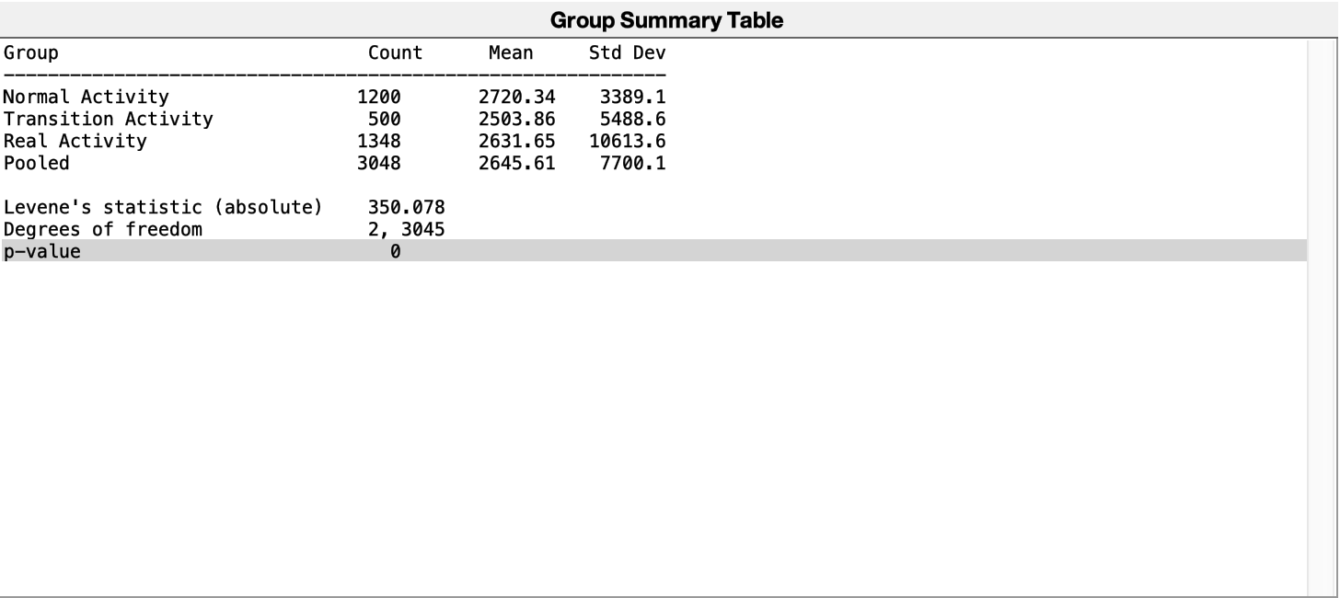
01 – Levene’s test for variance
$$H_{0}:σ_{i}=σ, ∀i, i=1, 2, 3$$
As we could have been expected from the graphical interpretation of the time series, the variance is different considering earthquake phases.

Slide 11
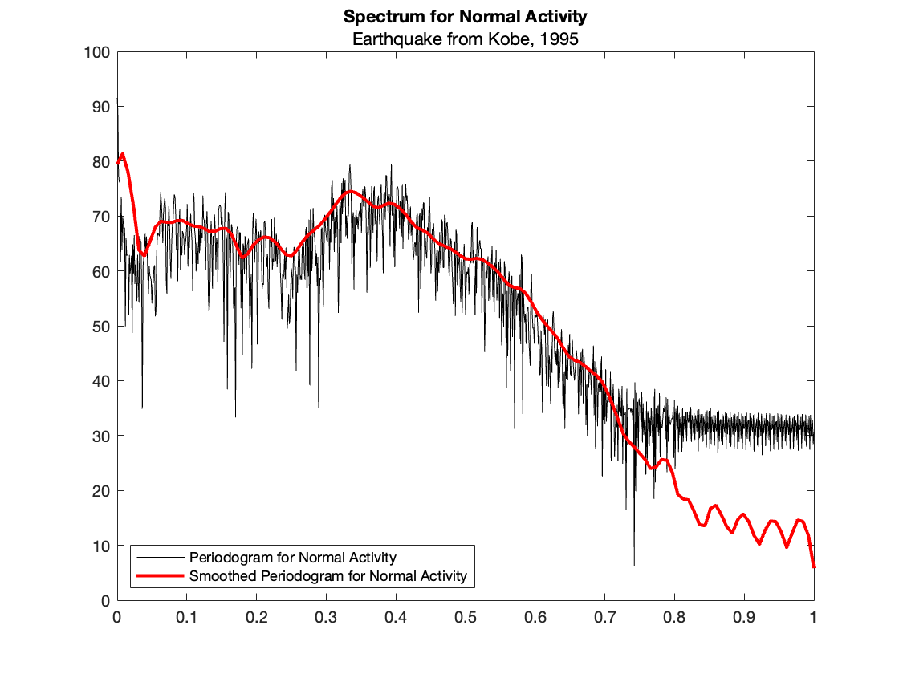
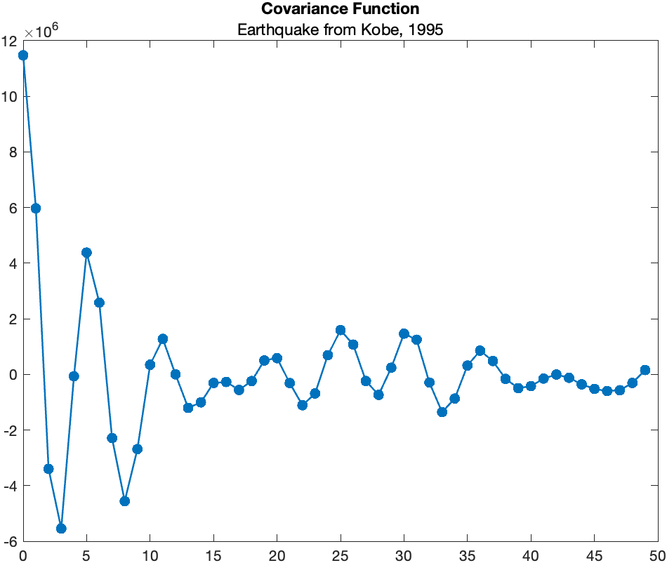
01 – Spectrum and covariance function

Slide 12
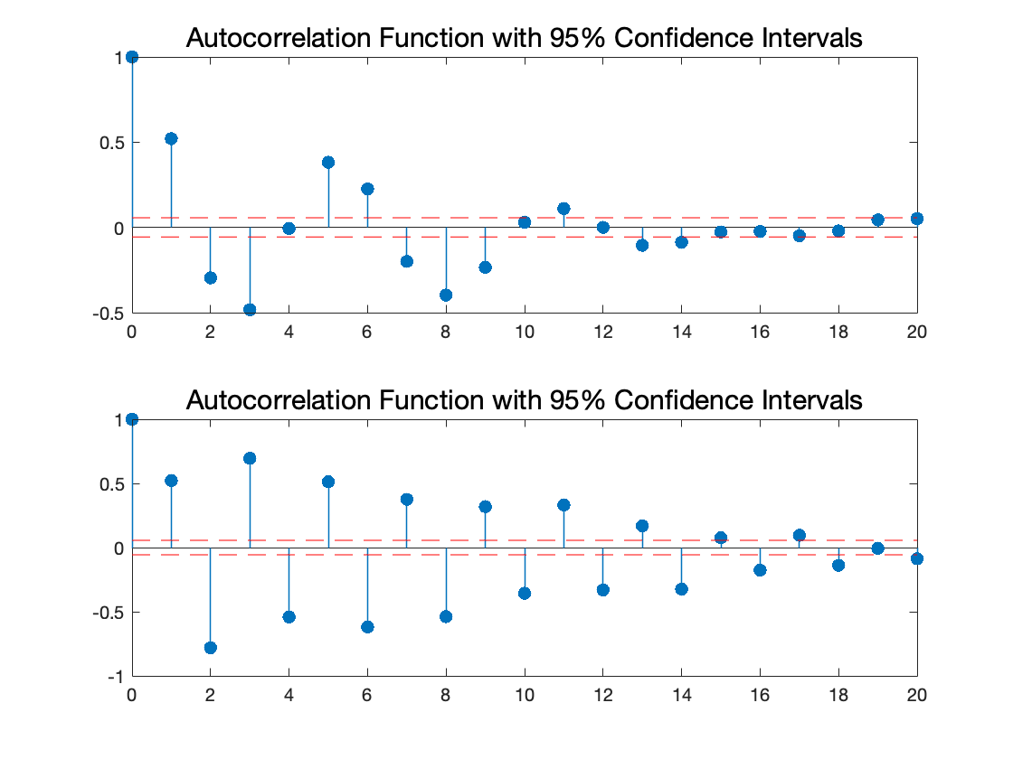
01 – ACF & PACF plots
Both the autocorrelation function and partial autocorrelation plots exhibit some criticalities. In particular we can see high values for lag up to 18. The oscillatory behaviour of the PAC function suggest us to search also for an MA part of the model. So we can expect to find a high order ARMA model.

Slide 13
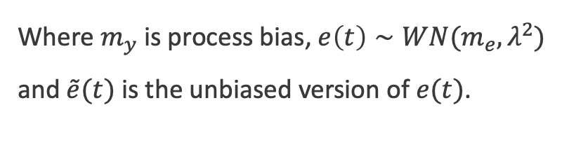
01 – Model structure
Where $m_{y}$ is process bias, $e\left(t\right)∼WN(m_{e},λ^{2})$ and $\tilde{e}(t)$ is the unbiased version of $e(t)$.

Slide 14
02 – Model Training
Train & validation split
Model training
Model selection
Analysis of model residuals

Slide 15
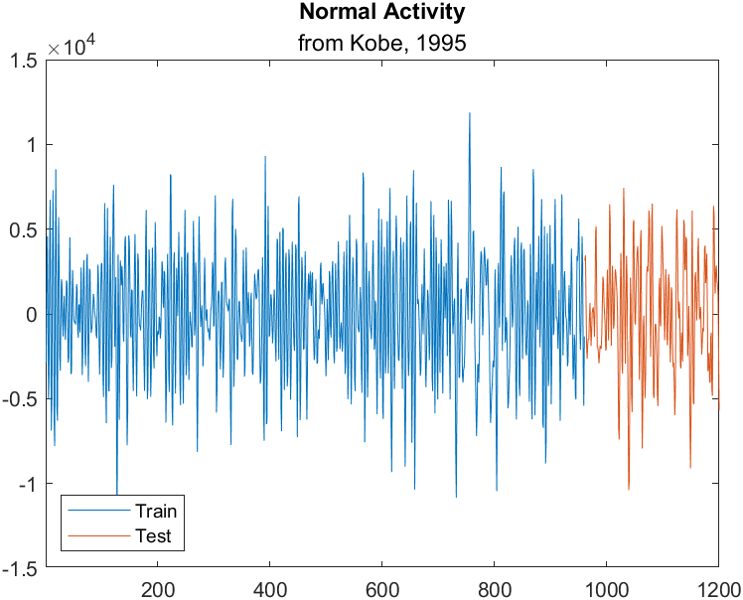
02 – Train & validation split
1200
Samples for Normal Activity
960
240
Training Data
Validation Data

Slide 16
02 – Model training
%% Estimate models
na = 1:40;
nc = 1:40;
ct = 1;
models = cell(1,1600);
for i = 1:40
na_ = na(i);
for j = 1:40
nc_ = nc(j);
models{ct} = armax(my_data_train,[na_ nc_]);
ct = ct+1;
end
end
To find the best model, I used an iterative approach to train models with different order combinations, both for AR and MA parts. Then I find the model that fitted the best training data.

Slide 17
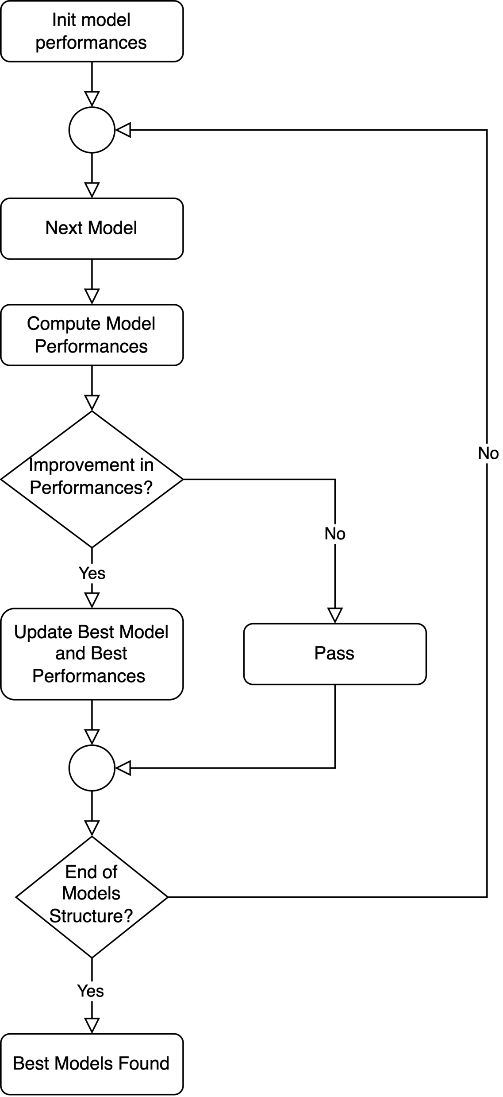
02 – Model selection
In the flowchart on the right, there is the description of the algorithm I used to find the best model for each criterion to assess model performances:
Mean Squared Error
Root Mean Squared Error
Akaike Information Criterion
Minimum Description Lenght
Mean Absolute Error
Final Prediction Error
Mean Absolute Percentage Error
Percentage of Fitting

Slide 18
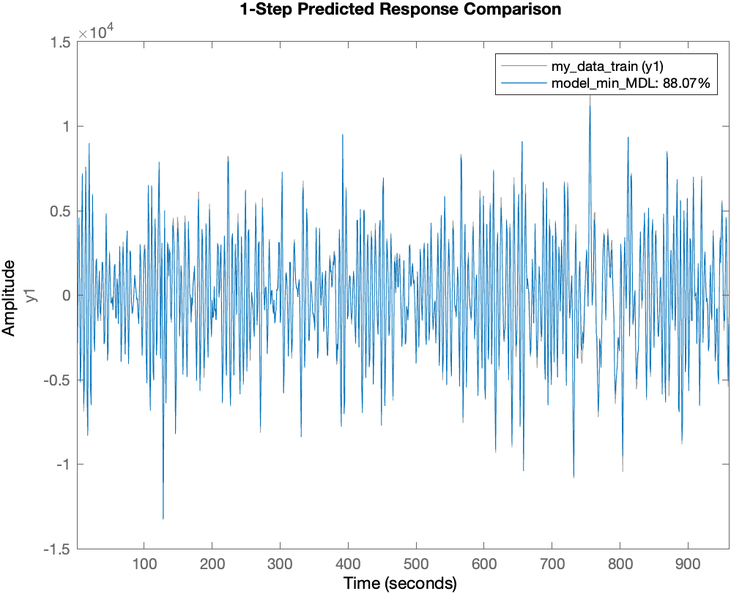
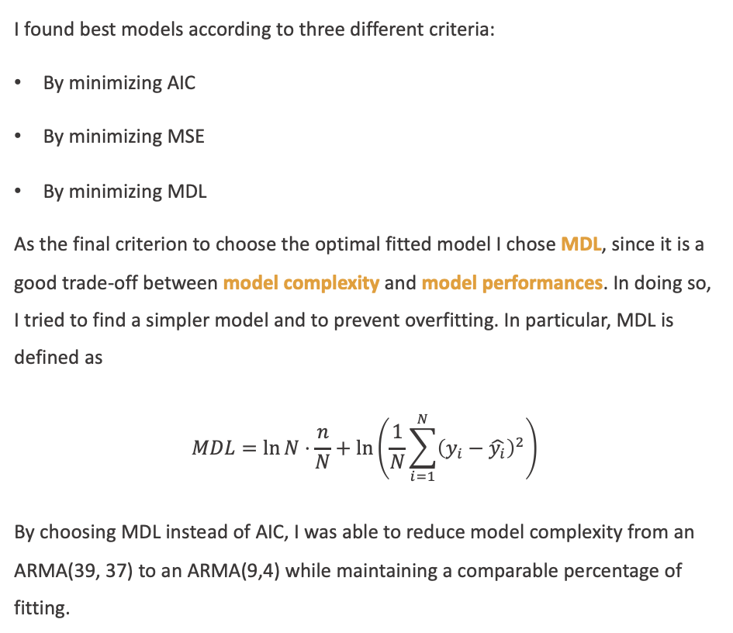
02 – Model selection
I found best models according to three different criteria:
By minimizing AIC
By minimizing MSE
By minimizing MDL
As the final criterion to choose the optimal fitted model I chose MDL, since it is a good trade-off between model complexity and model performances. In doing so, I tried to find a simpler model and to prevent overfitting. In particular, MDL is defined as
$$MDL=\ln{N}⋅\frac{n}{N}+\ln\left(\frac{1}{N}\sum_{i=1}^{N}{{\left(y_{i}−\hat{y_{i}}\right)}^{2}}\right)$$
By choosing MDL instead of AIC, I was able to reduce model complexity from an ARMA(39, 37) to an ARMA(9,4) while maintaining a comparable percentage of fitting.
Model | AR order | MA order | n | Fit percentage
model_min_AIC | 39 | 37 | 76 | 89.34%
model_min_MSE | 39 | 37 | 76 | 89.34%
model_min_MDL | 9 | 4 | 13 | 88.07%

Slide 19
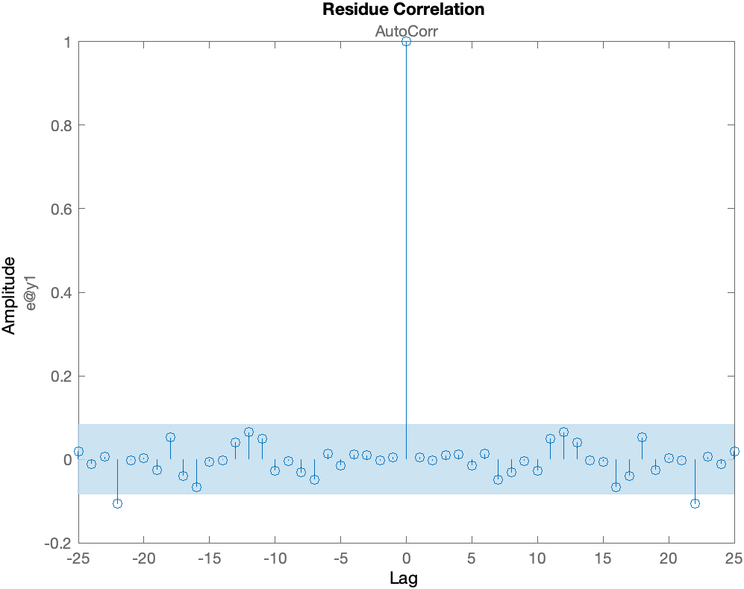
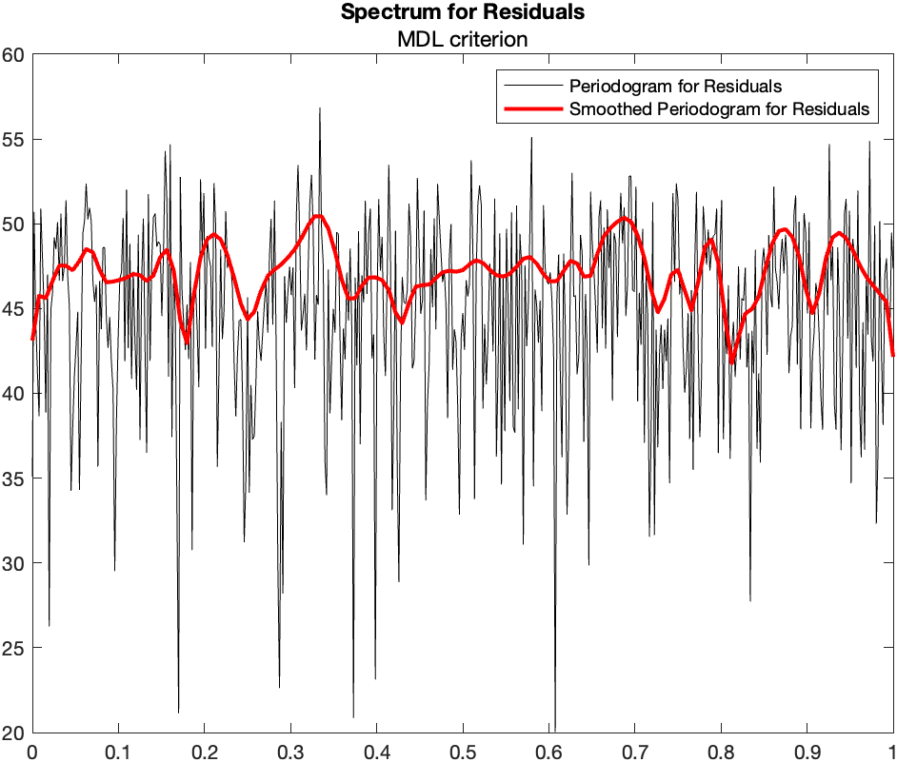
02 – Model residuals

Slide 20
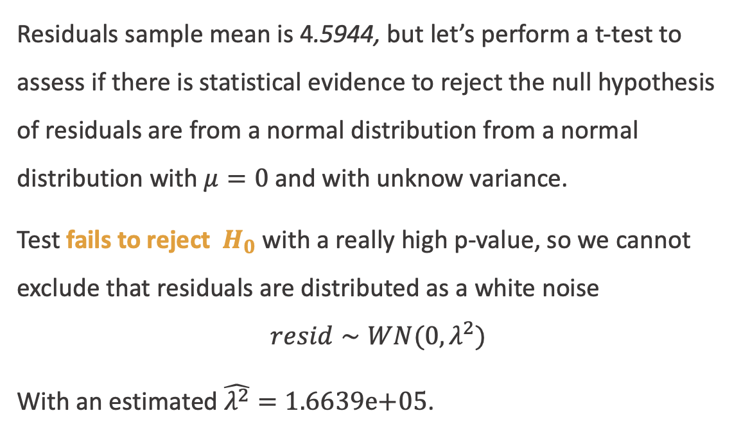
02 – Model residuals
Residuals sample mean is 4.5944, but let’s perform a t-test to assess if there is statistical evidence to reject the null hypothesis of residuals are from a normal distribution from a normal distribution with $μ=0$ and with unknow variance.
Test fails to reject $H_{0}$ with a really high p-value, so we cannot exclude that residuals are distributed as a white noise
$$resid∼WN(0,λ^{2})$$
With an estimated $\hat{λ^{2}}=1.6639\text{e}\text{+05}$.
Result of t-test:
h =
0
p =
0.7272
ci =
-21.2417
30.4304

Slide 21
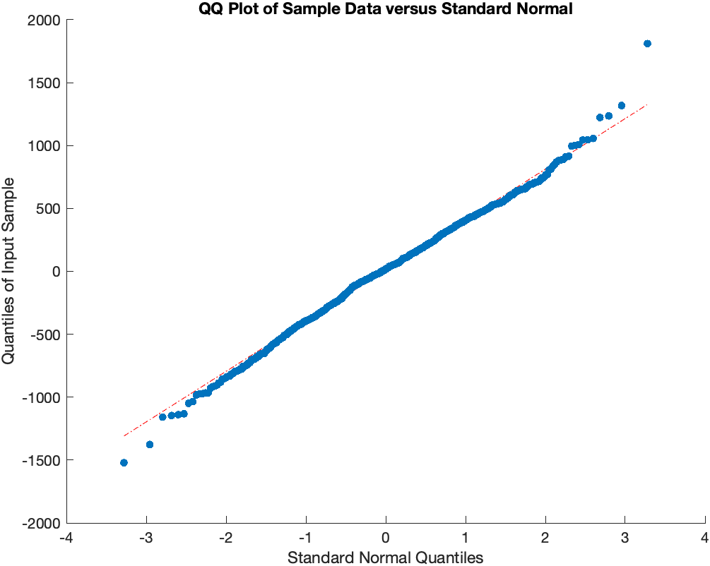
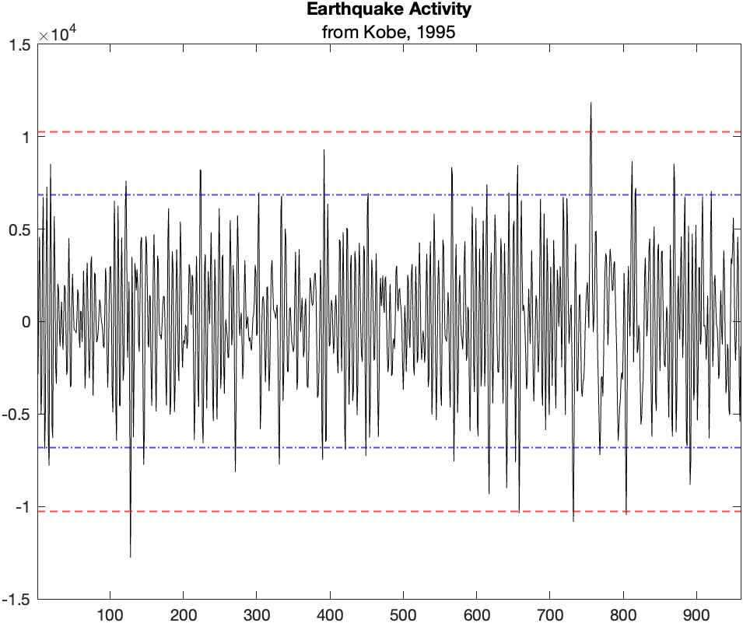
02 – Model residuals
124° obs
124° obs

Slide 22
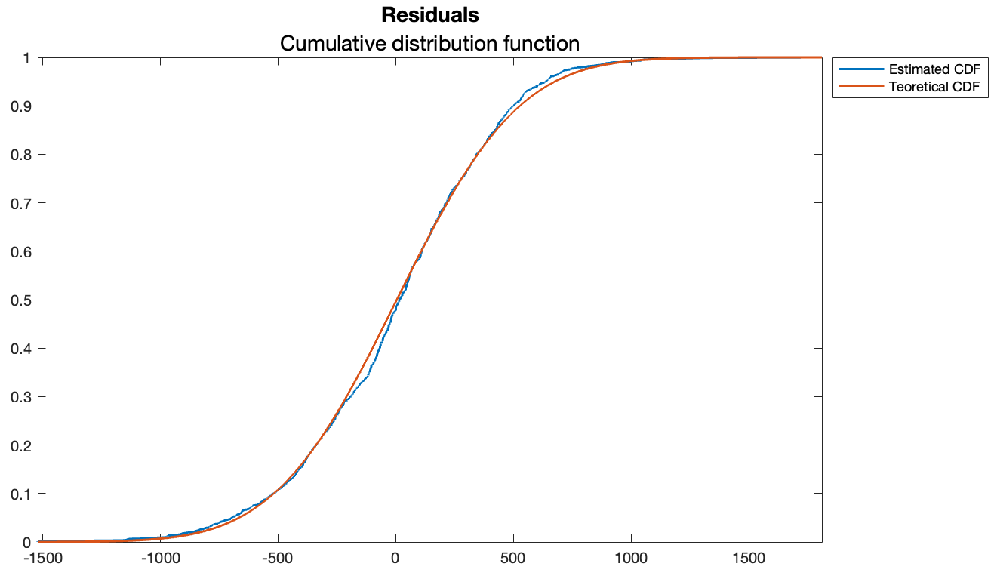
02 – Model residuals
Remember, in our case, N = 960 which is a pretty low sample size.
Critical observations: [124 121 152 948 130 145 802 145 176 125 745 384 226]
Result of ad-test:
h =
1
p =
0.0131
Result of ad-test without critical points:
h =
1
p =
0.0494

Slide 23
03 – Model Validation
Model validation
Model performances
Final model

Slide 24
03 – Bias-variance trade-off
We are interested in minimizing model error in predicting new observations, so we have to asses the model against the validation set. We need to check if the model we find is overfitting our data.

Slide 25
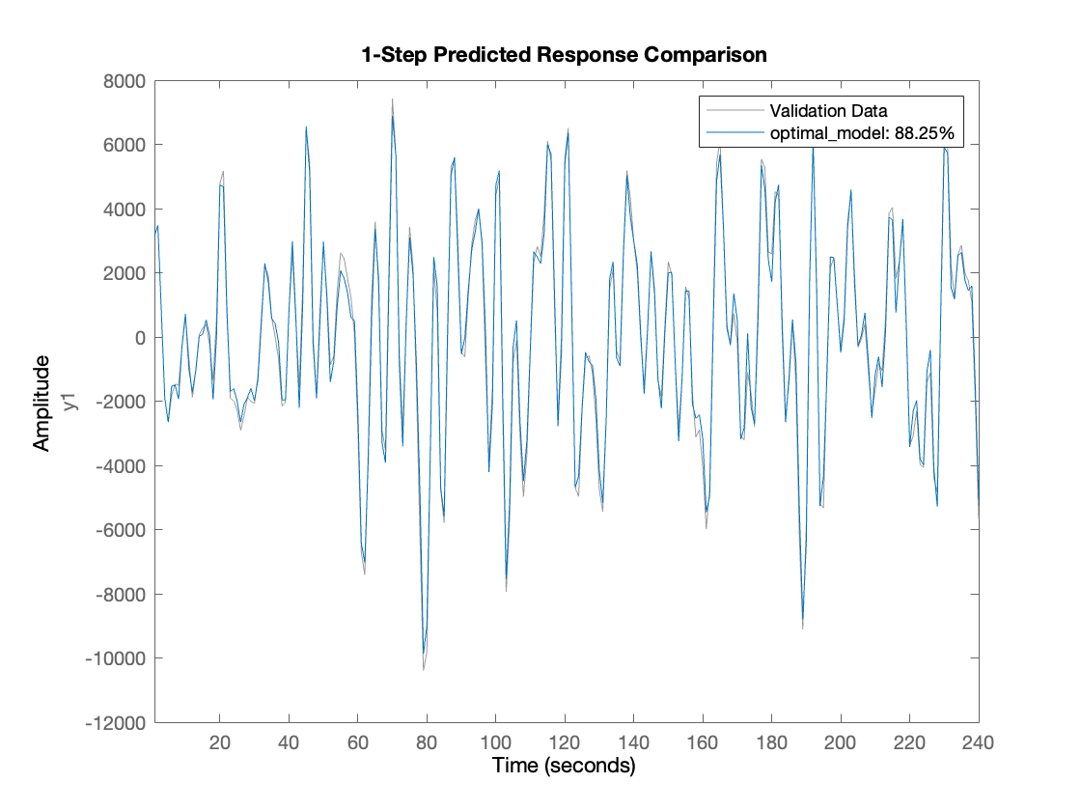
03 – Model performances
To check If the model I found previously, I decided to assess model performances on the validation set. and model performances, I decided to use MDL criterion. As we can see from the table, performances on both training and validation set of the model are comparable. The model is not overfitting.
Performances | Training Data | Validation Data
MSE | 1.6624e+05 | 1.4725e+05
RMSE | 407.7244 | 383.7377
MAE | 318.7848 | 302.7615
MAPE | 1.7889 | 15.2884
AIC | 24.0694 | 23.9082
MDL | 12.1142 | 12.1968
Fit percentage | 88.07% | 88.25%

Slide 26
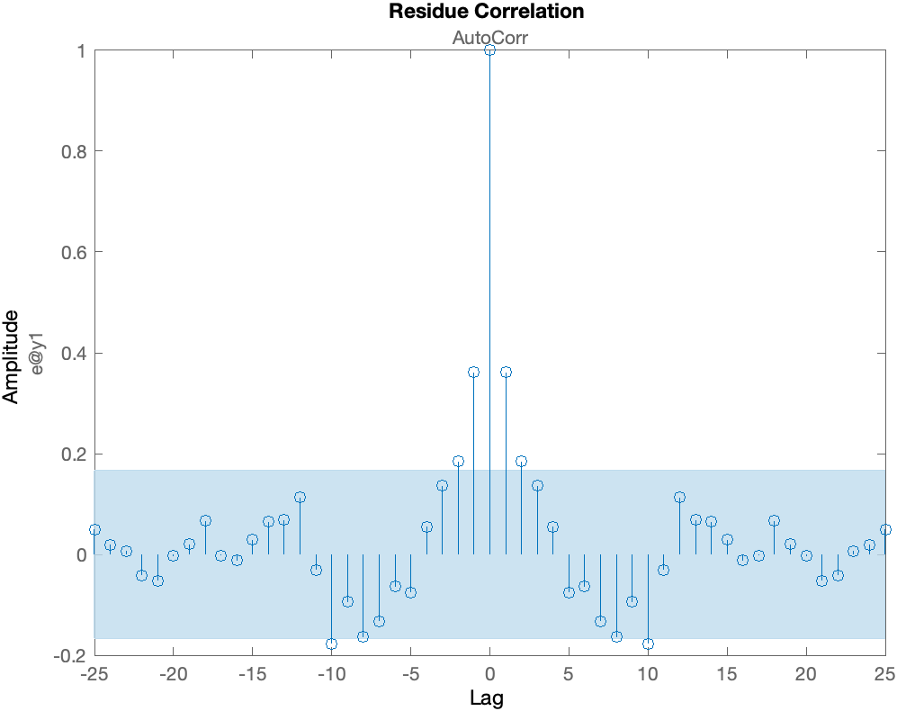
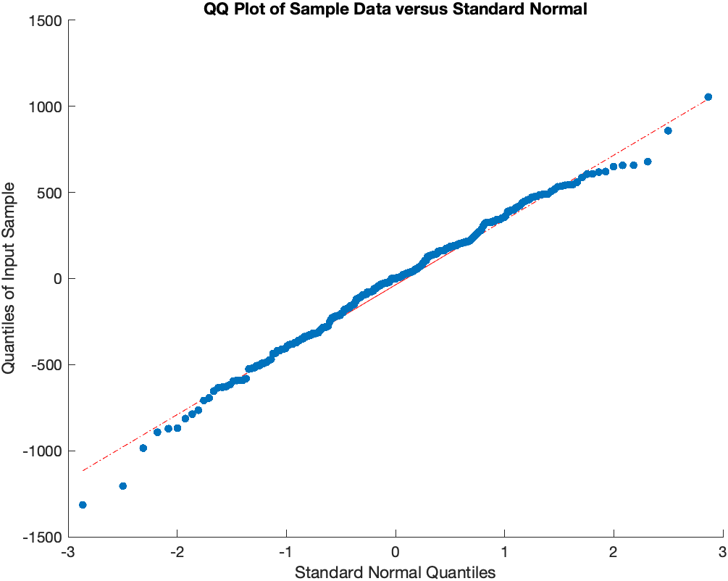
03 – Validation set residuals
Result of AD-test:
h =
0
p =
0.2665

Slide 27
03 – Finally… the model
The optimal model is an ARMA(9, 4).
$$W\left(z\right)=\frac{1 + 1.791{ z}^{−1} − 0.0845{ z}^{−2} − 1.744{ z}^{−3} − 0.8635{ z}^{−4}}{1 − 1.718{ z}^{−1} + 1.805{ z}^{−2} − 1.215 z^{−3} + 0.03484 z^{−4} + 0.6637 z^{−5} − 0.9679 z^{−6} + 0.8373 z^{−7} − 0.3713 z^{−8}+ 0.1345z^{−9} }$$

Slide 28
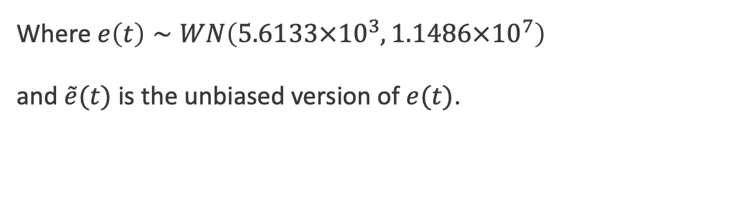
03 – Finally… the model
Where $e\left(t\right)∼WN\left(5.6133×{10}^{3},1.1486×{10}^{7}\right)$
and $\tilde{e}(t)$ is the unbiased version of $e(t)$.

Slide 29
04 – Model performances
Model stationarity
Error to signal ratio vs prediction horizon
FPE vs prediction horizon

Slide 30
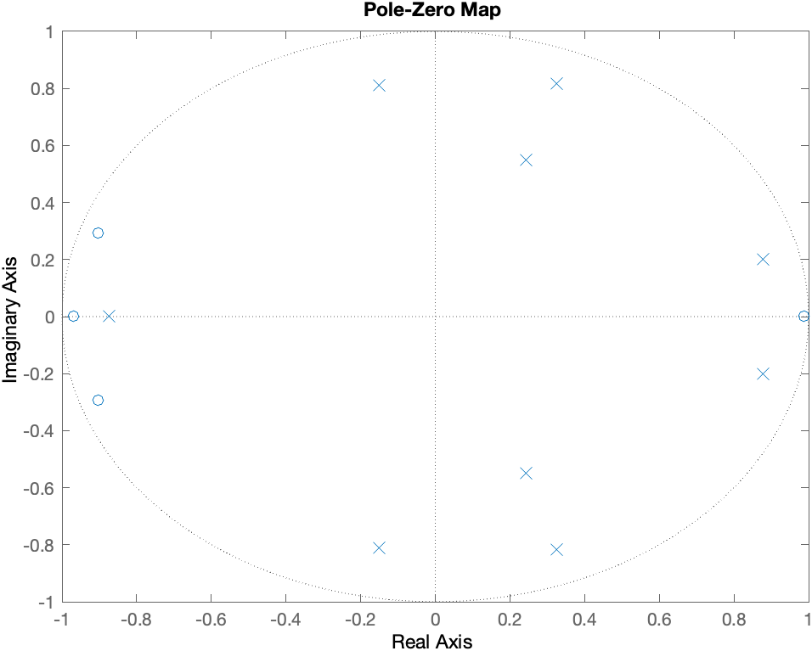
04 – Model stationarity
An ARMA model is stationary if:
The input is a SSP
The transfer function is asymptotically stable
The input is a SSP by definition and the transfer function is asymptotically stable since all poles are inside the unitary radius circle.
The model is stationary.

Slide 31
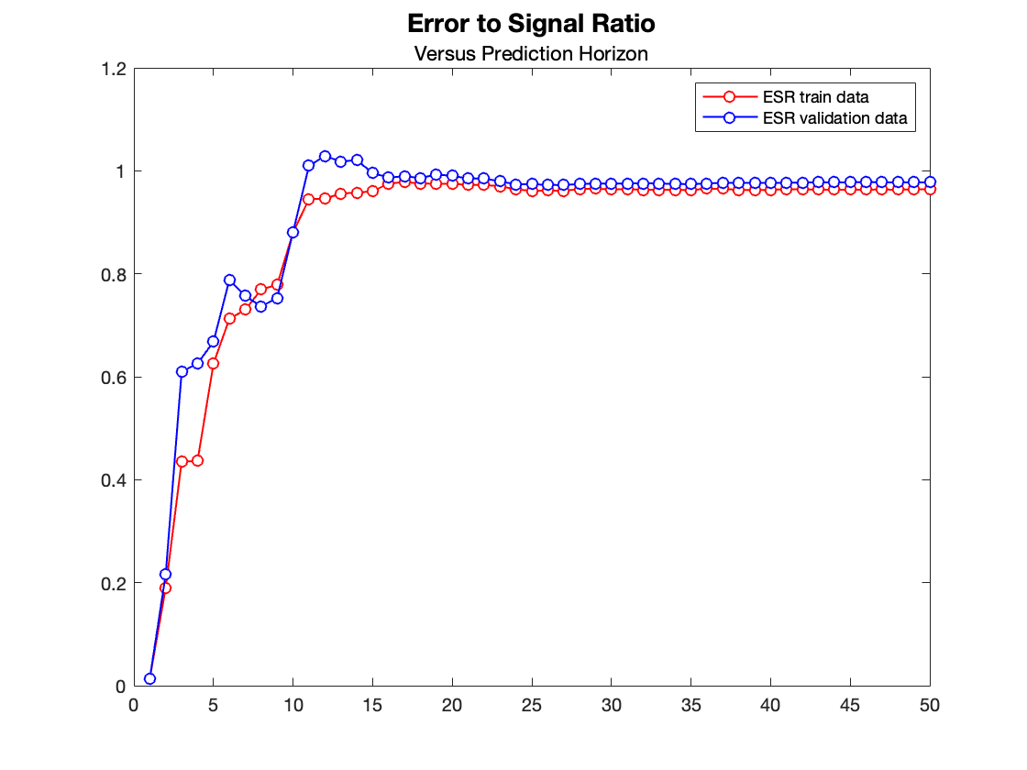
04 – Error to signal ratio
1-step-ahead predictor
Training: 1.42%
Validation: 1.38%
2-step-ahead predictor
Training: 18.98%
Validation: 21.62%
3-step-ahead predictor
Training: 43.53%
Validation: 60.98%

Slide 32
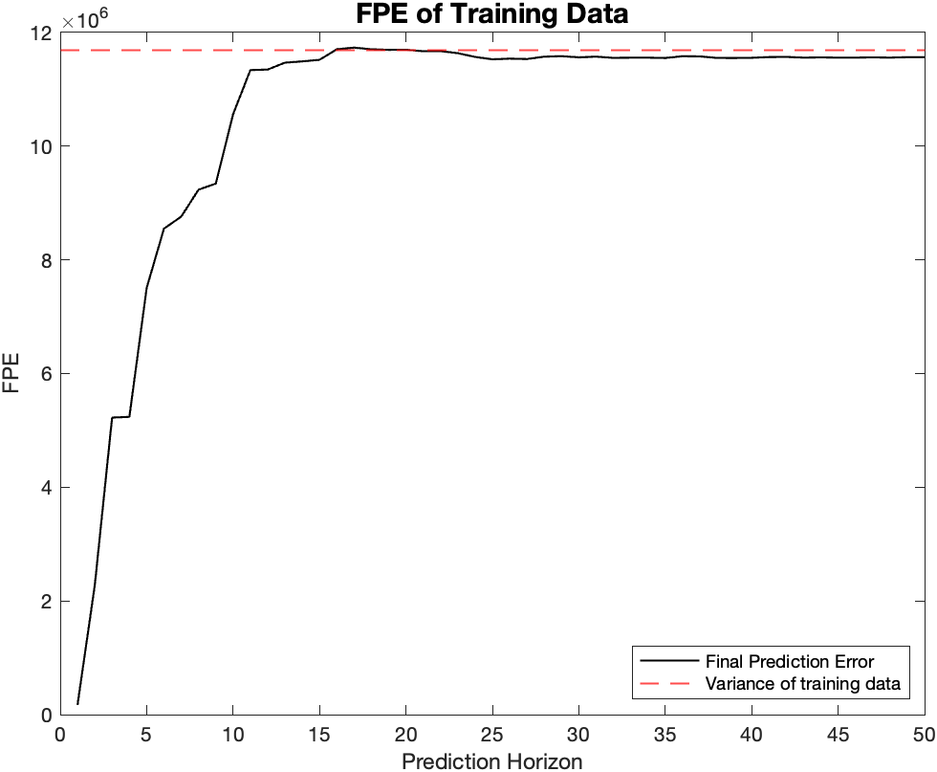
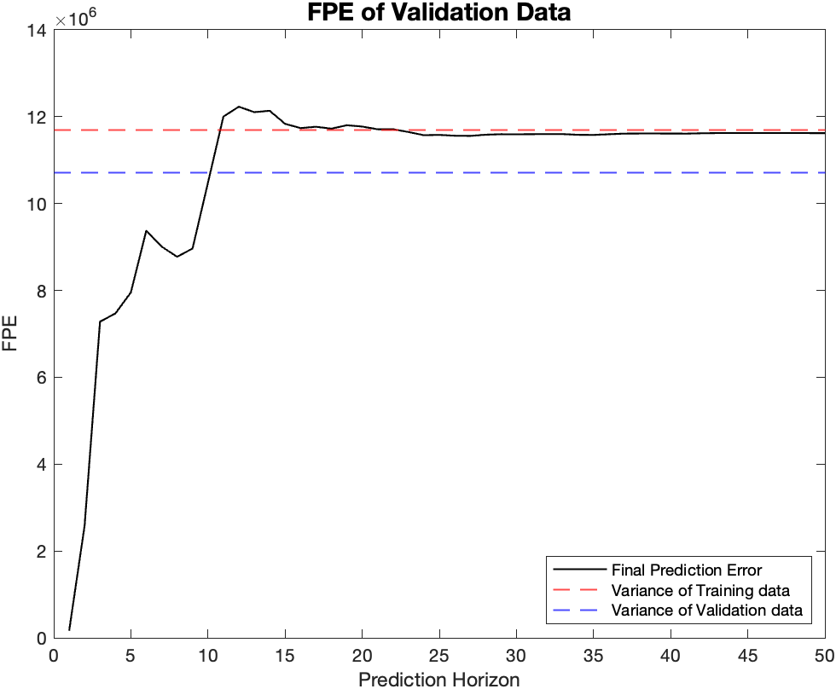
04 – FPE versus prediction horizon to signal ratio

Slide 33
05 – Can we predict an earthquake?

Slide 34
05 – The idea
I found a model which describes the dynamics of the normal activity. If the error in prediction increases, the dynamics of the seismic activity is changed. I chose the MSE as a metric to asses model performances.

Slide 35

05 – Why the mean squared error?
1.
Since the nature of the process is oscillatory, I want to prevent error decreasing due to changing in errors sign. The MSE (by nature) avoids this to happening.
2.
I want to «amplify» larger error. By using MSE the error in prediction will follow an exponential behaviour, making it more easily identifiable.

Slide 36
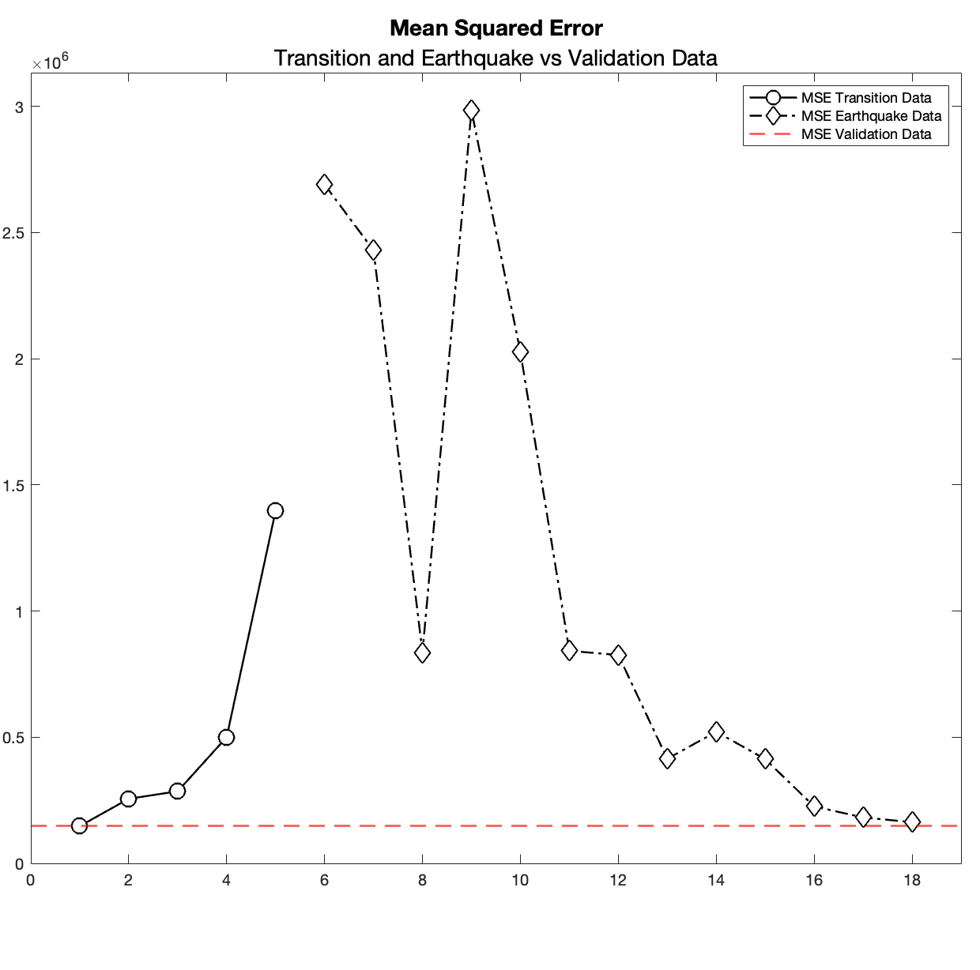
05 – MSE on transition and earthquake activities
-400 sec
to earthquake
The MSE starts increasing
-200 sec
to earthquake
The MSE is sharply increased
Each time-window is 100 seconds

Slide 37
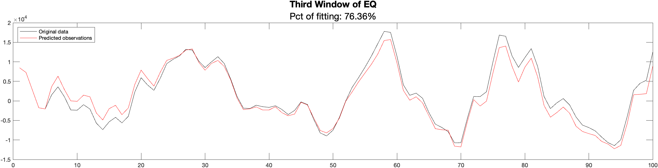
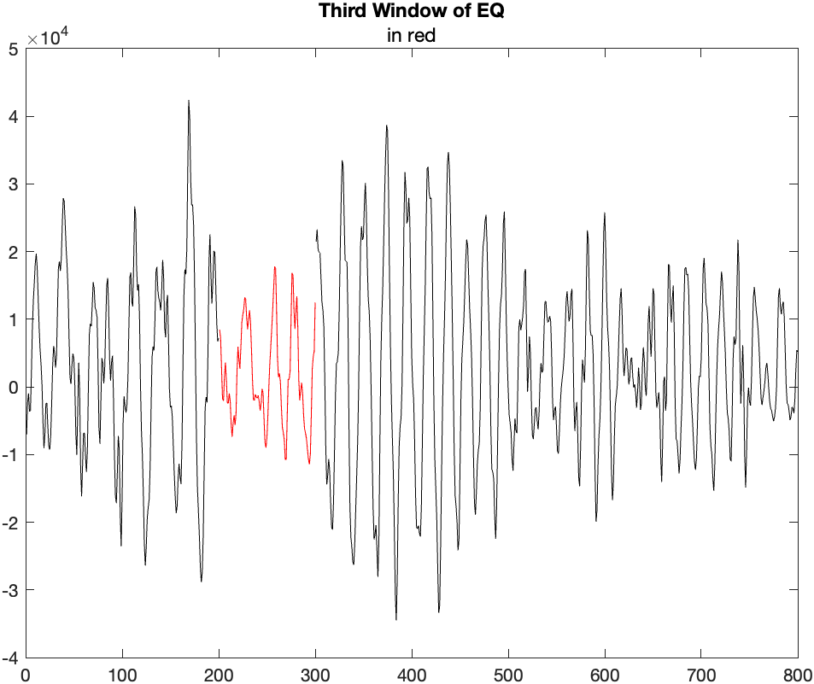
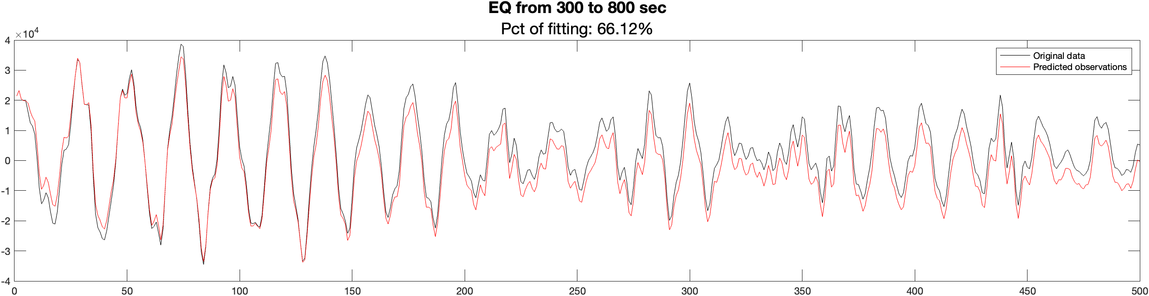
05 – Third time window of EQ

Slide 38
06 – A control chart approach
Data normality and false alarm rate
I-MR control chart
MA control chart
EWMA control chart

Slide 39
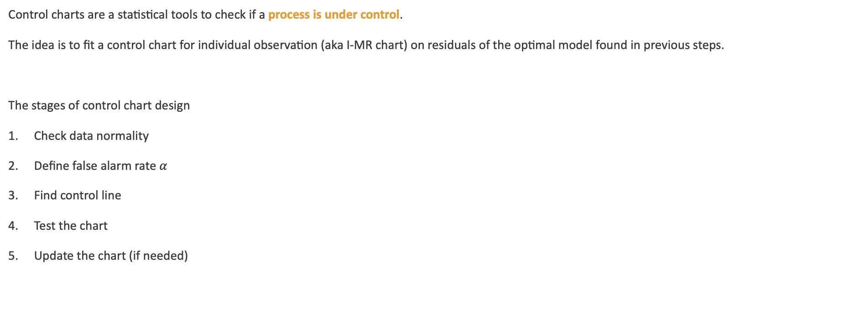
05 – A control chart approach
Control charts are a statistical tools to check if a process is under control.
The idea is to fit a control chart for individual observation (aka I-MR chart) on residuals of the optimal model found in previous steps.
The stages of control chart design
Check data normality
Define false alarm rate $α$
Find control line
Test the chart
Update the chart (if needed)
Real time monitoring

Slide 40
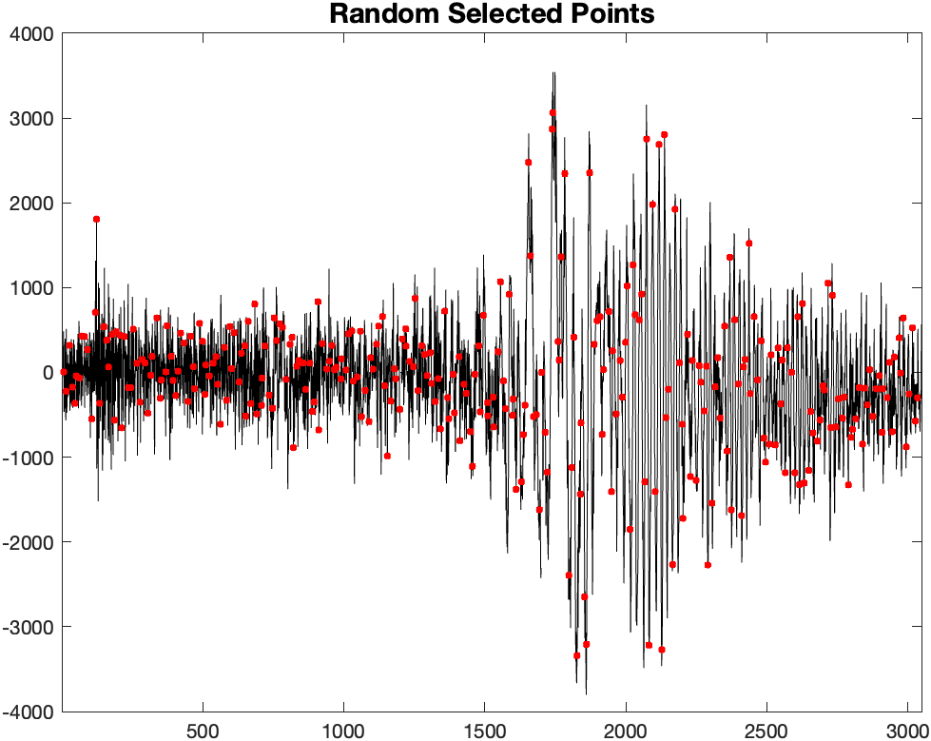
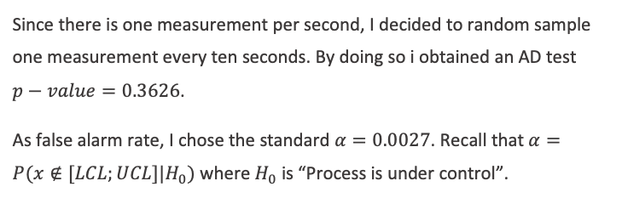
05 – Data normality and false alarm rate
Since there is one measurement per second, I decided to random sample one measurement every ten seconds. By doing so i obtained an AD test $p−value=0.3626$.
As false alarm rate, I chose the standard $α=0.0027$. Recall that $α=P(x∉[LCL;UCL]|H_{0})$ where $H_{0}$ is “Process is under control”.
%% Random sampling
WindowLength = 10;
t_train = zeros(floor(length(t_train_or)/WindowLength),1);
e_train = zeros(floor(length(e_train_or)/WindowLength),1);
for idx = 1:floor(length(t_train_or)/WindowLength)
Block_e = e_train_or((idx-1)*WindowLength+1:idx*WindowLength);
Block_t= t_train_or((idx-1)*WindowLength+1:idx*WindowLength);
i = randi([1 WindowLength], 1, 1);
t_train(idx) = Block_t(i);
e_train(idx) = Block_e(i);
end

Slide 41
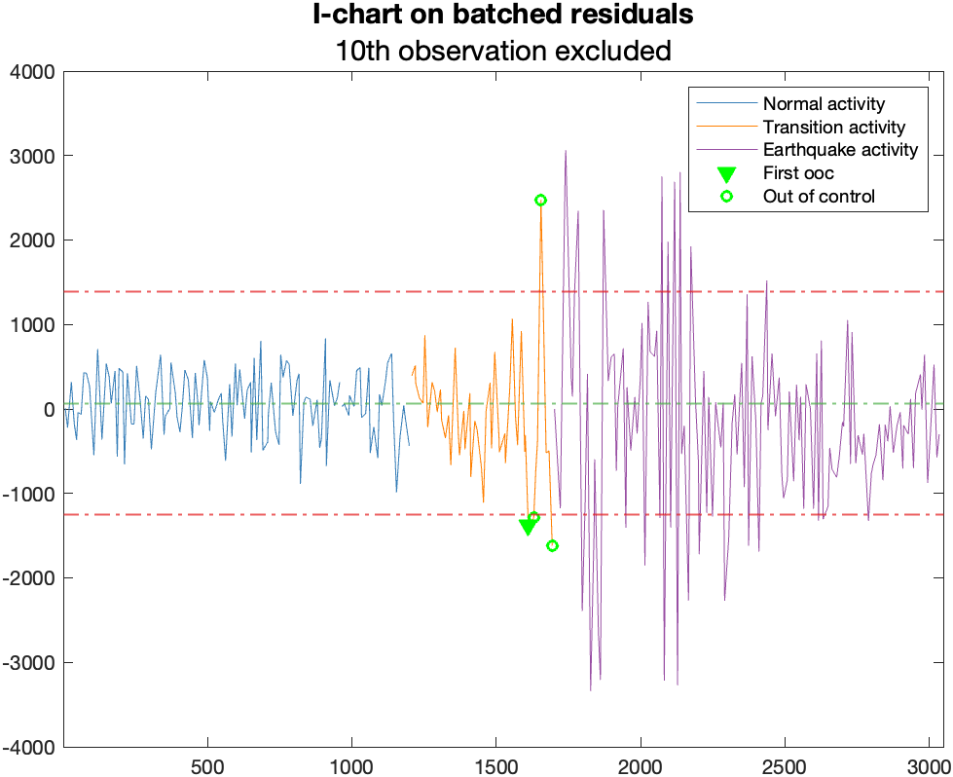
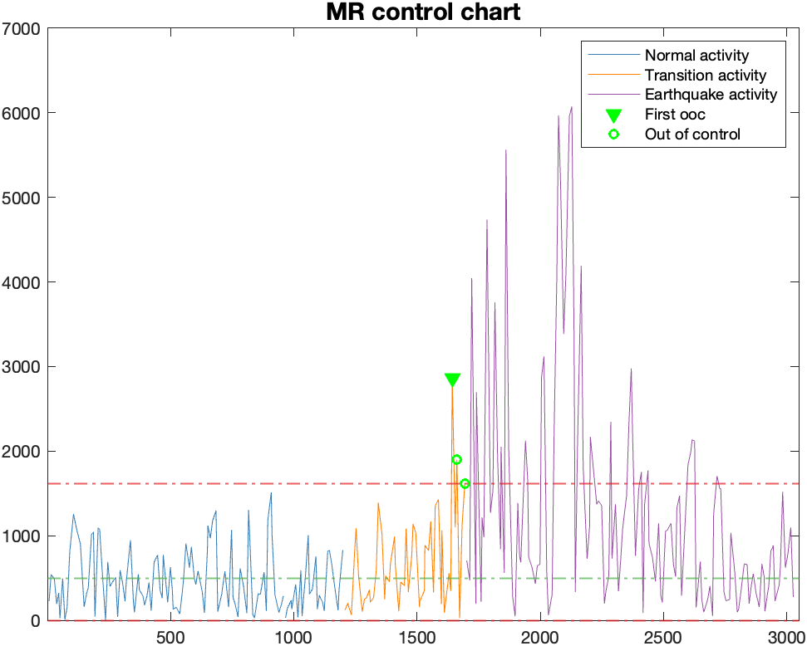
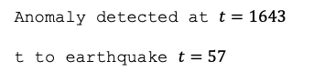
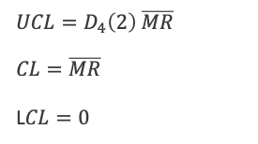
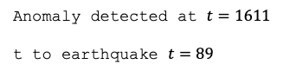
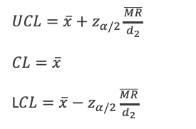
05 – I-MR chart
$UCL=\overline{x}+z_{α/2}\frac{\overline{MR}}{d_{2}}$
$CL=\overline{x}$
L$CL=\overline{x}−z_{α/2}\frac{\overline{MR}}{d_{2}}$
Anomaly detected at $t=1611$
t to earthquake $t=89$
$UCL=D_{4}\left(2\right) \overline{MR}$
$CL=\overline{MR}$
L$CL=0$
Anomaly detected at $t=1643$
t to earthquake $t=57$

Slide 42
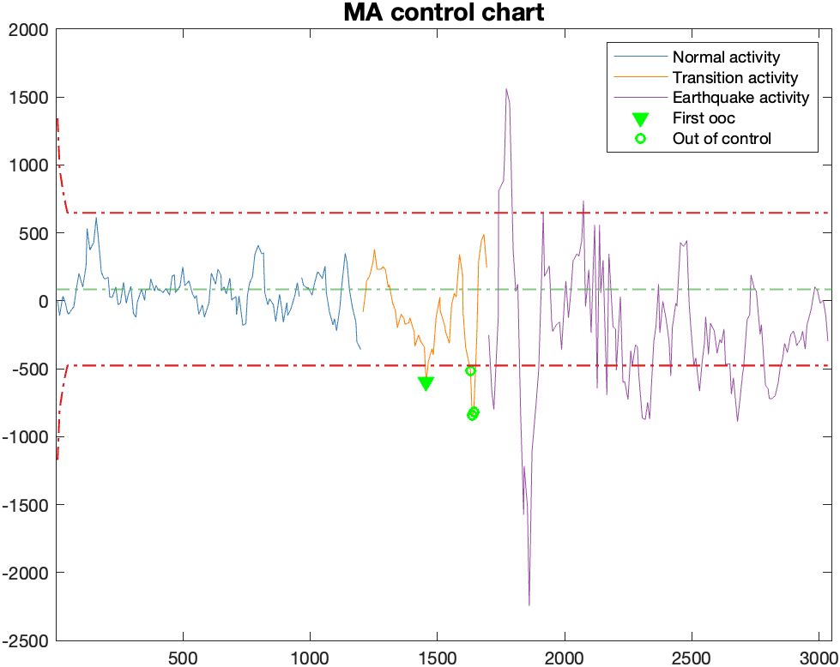
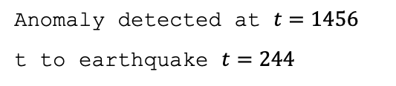
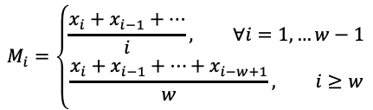
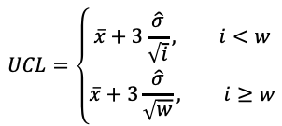
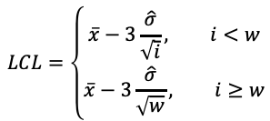
05 – MA chart
$$M_{i}=\left\{\begin{aligned}\frac{x_{i}+x_{i−1}+…}{i}&, ∀i=1,…w−1 \\ \frac{x_{i}+x_{i−1}+…+x_{i−w+1}}{w}, i≥w\end{aligned}\right.$$
$$UCL=\left\{\begin{aligned}\overline{x}+3\frac{\hat{σ}}{\sqrt{i}}&, i<w \\ \overline{x}+3\frac{\hat{σ}}{\sqrt{w}}, i≥w\end{aligned}\right.$$
$$CL=\overline{x}$$
$$LCL=\left\{\begin{aligned}\overline{x}−3\frac{\hat{σ}}{\sqrt{i}}&, i<w \\ \overline{x}−3\frac{\hat{σ}}{\sqrt{w}}, i≥w\end{aligned}\right.$$
Anomaly detected at $t=1456$
t to earthquake $t=244$

Slide 43
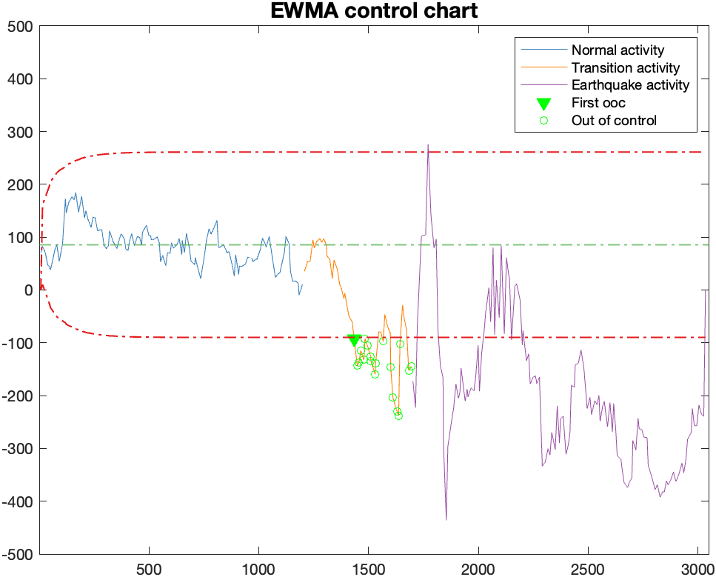





05 – EWMA chart
$$z_{i}=\left\{\begin{aligned}\overline{x}&, i=0 \\ \\ λx_{i}+\left(1−λ\right)z_{i−1}, i≥0\end{aligned}\right.$$
$$UCL=\overline{x}+L\hat{σ}\sqrt{\frac{λ}{2−λ}\left[1−{\left(1−λ\right)}^{2i}\right]}$$
$$CL=\overline{x}$$
$$LCL=\overline{x}−L\hat{σ}\sqrt{\frac{λ}{2−λ}\left[1−{\left(1−λ\right)}^{2i}\right]}$$
Anomaly detected at $t=1456$
t to earthquake $t=244$
$λ=0.05$
$L=2.615$
As suggested by Lucas and Saccucci in 1990 in their paper

Slide 44
07 – Conclusion

Slide 45

Source https://publications.iafss.org/publications/fss/1/523/view/fss_1-523.pdf
A Case Study of Fire and Evacuation in a Multi-Purpose Office Building, Osaka, Japan
S. HORIUCHI
05 – Conclusion
I suggested to use a system composed by the joint monitoring of MSE and the use of the EWMA control chart. The latter allow us to search for a pattern of anomalies, the larger the number of anomalies the greater the probability an earthquake is about to occur.
Actually, we can save lives.
Some advices for geographic areas at high seismic risk:
Construct the small buildings in such a way that the escape routes are preferably passable in no more than 400 seconds and in any case no more than 200 seconds.
Construct big buildings (like offices and hospitals) so that there are safe shelters accessible at less than 400 seconds for visitors and shelters accessible at less than 200 seconds for regular visitors.
The main target should be large buildings since escape is more difficult in the presence of many people and in the presence of non-regular users. In small buildings, in fact, it is much more difficult for nonregular users to be present.

Slide 46

Thanks for the attention.
Any question?

